Slide 1

6th Grade Accelerated Math
Unit 7, Lesson 2 Area of Triangles- Part 2 Volume 1, pg. 302

Slide 2


Benchmark
MA.6.GR.2.1
Derive a formula for the area of a right triangle using a rectangle. Apply a formula to find the area of a triangle.
volume 1, pg. 302

Slide 3
Integrated Mathematical Thinking and Reasoning Standards
MA.K12.MTR.1.1 Actively participate in effortful learning both individually and collectively.
MA.K12.MTR.4.1 Engage in discussions that reflect on the mathematical thinking of self and others.
MA.K12.MTR.6.1 Assess the reasonableness of solutions.
volume 1, pg. 302

Slide 4

Learning Target
I can apply a formula to find the area of triangles.
volume 1, pg. 302

Slide 5

Warm-Up
volume 1, pg. 303

Slide 6
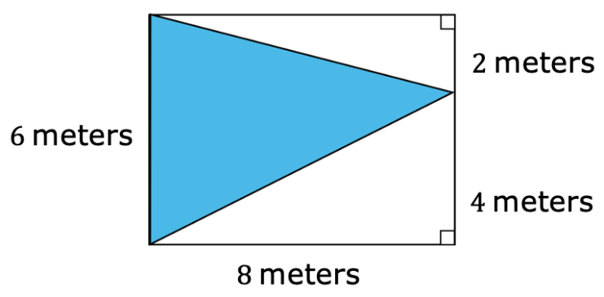
7.2.1 Warm-Up: Bell Work
What is the area of the rectangle? Include units.
What is the area of the shaded triangle? Include units.
Explain the relationship between the area of a rectangle and triangle that have the same height and base.
volume 1, pg. 303

Slide 7

Guided Instruction
volume 1, pg. 303

Slide 8


7.2.2 Guided Instruction: Find the Area of a Triangle
To find the area of any triangle, identify a base of the triangle and its corresponding height.
Any of the three sides of a triangle can be the base. The term “base” can refer to the side of a triangle and also its measurement.
The corresponding height of a triangle is the length of the perpendicular segment drawn from a base to its opposite vertex. The opposite vertex is the vertex of the triangle that is not an endpoint of the base.
volume 1, pg. 303

Slide 9
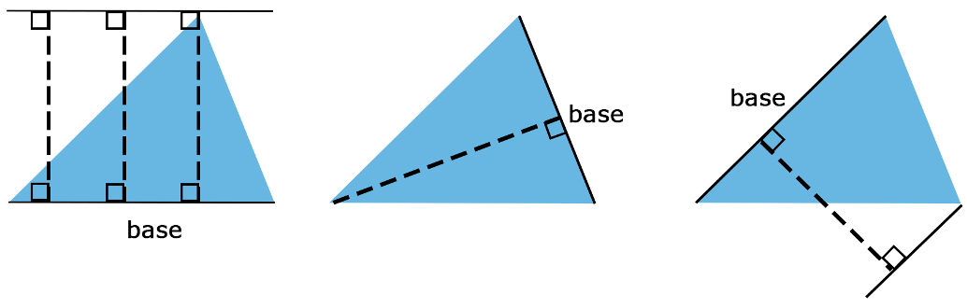
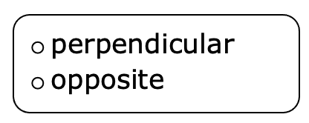
Examples of bases and their corresponding heights on copies of the same triangle are shown. Each dashed line segment represents the height of the triangle.
In each example the height is
to the base.
volume 1, pg. 303

Slide 10
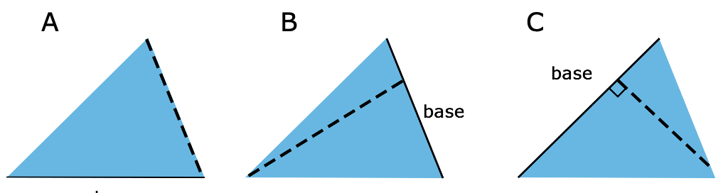
The side used for the base is labeled on three triangles below. Complete the table to explain why each of the dashed lines do not represent the height of each triangle.
volume 1, pg. 304

Slide 11
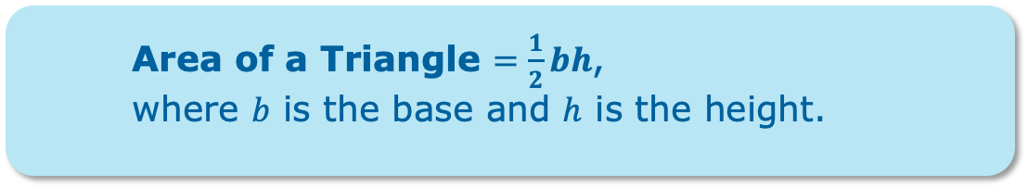
Triangle | Explanation
Triangle A
Triangle B
Triangle C
Area of a Triangle $=\frac{1}{2}bh$,
where $b$ is the base and $h$ is the height.
volume 1, pg. 304

Slide 12
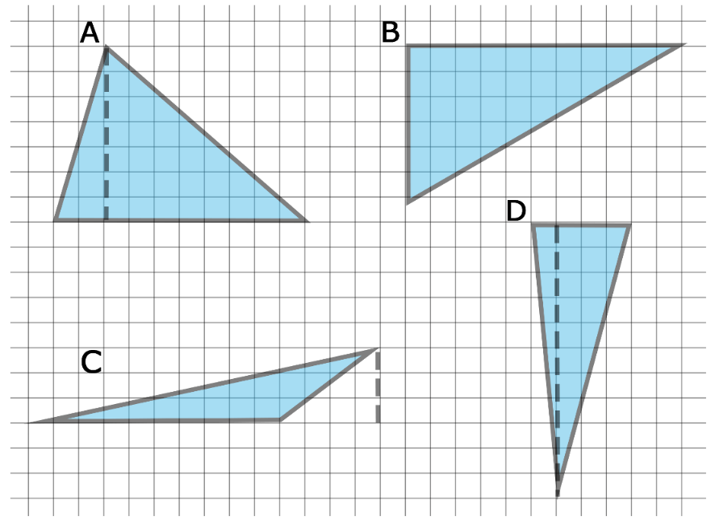

Four triangles are shown on the grid. The side length of each square on the grid is $1$ centimeter (cm).
For each triangle, label the line segment that is drawn to represent the height, $h$. Then, label the side that is the base, $b$.
volume 1, pg. 304

Slide 13
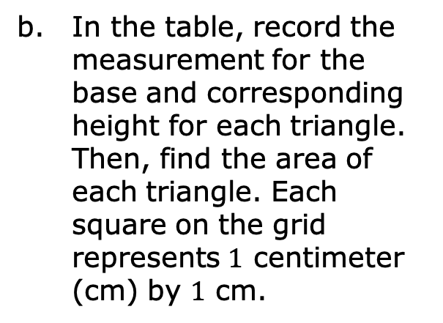
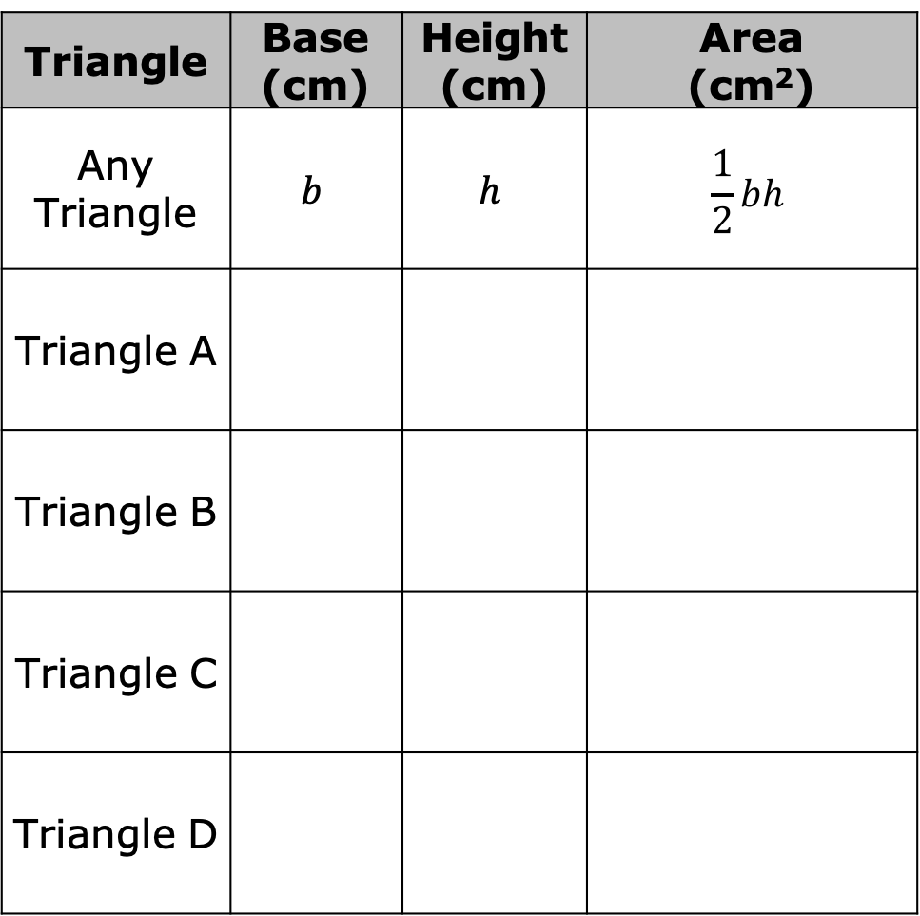
In the table, record the measurement for the base and corresponding height for each triangle. Then, find the area of each triangle. Each square on the grid represents $1$ centimeter (cm) by $1$ cm.
Triangle | Base (cm) | Height (cm) | Area (cm²)
Any Triangle | $$b$$ | $$h$$ | $$\frac{1}{2}bh$$
Triangle A
Triangle B
Triangle C
Triangle D
volume 1, pg. 305

Slide 14

Guided Practice
volume 1, pg. 305

Slide 15

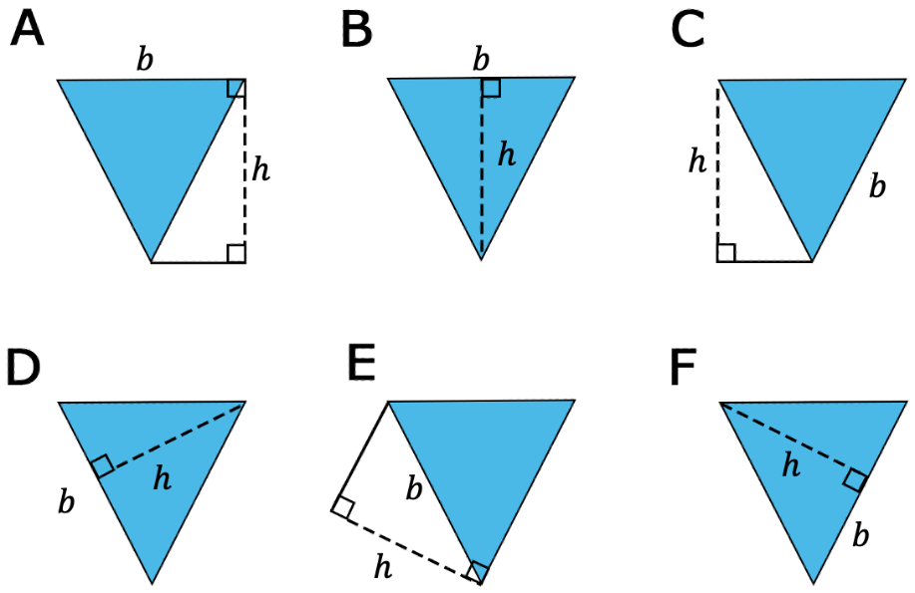
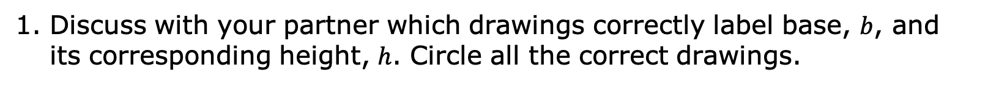
7.2.3 Guided Practice: Find the Area of a Triangle
Discuss with your partner which drawings correctly label base, $b$, and its corresponding height, $h$. Circle all the correct drawings.
volume 1, pg. 305

Slide 16
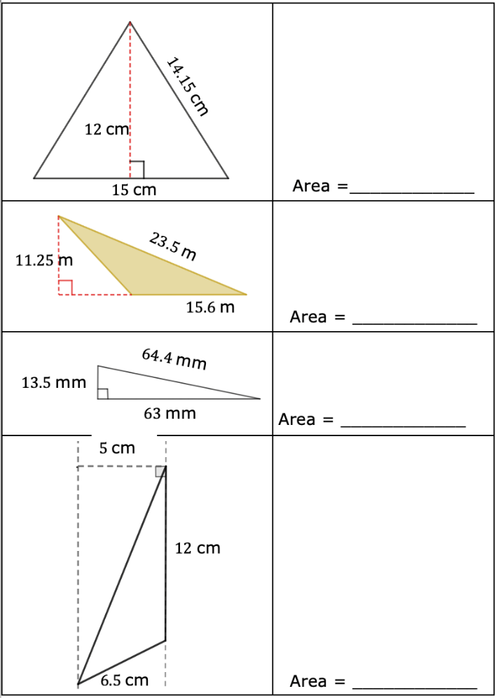
For each triangle below, circle the base measurement and put a square around the height measurement. Then, use the base and height to find the area of each triangle. Show your work. Include units.
volume 1, pg. 306

Slide 17

Your Turn
volume 1, pg. 306

Slide 18
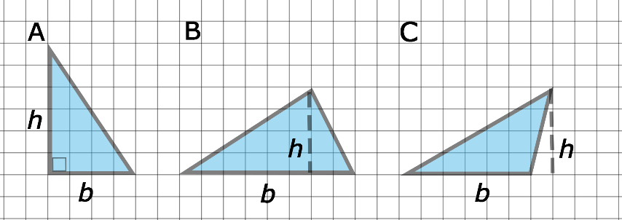
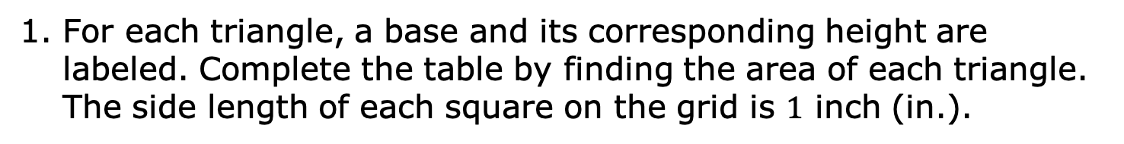
7.3.4 Your Turn!
For each triangle, a base and its corresponding height are labeled. Complete the table by finding the area of each triangle. The side length of each square on the grid is $1$ inch (in.).
Triangle | Area (in²)
A
B
C
volume 1, pg. 306

Slide 19
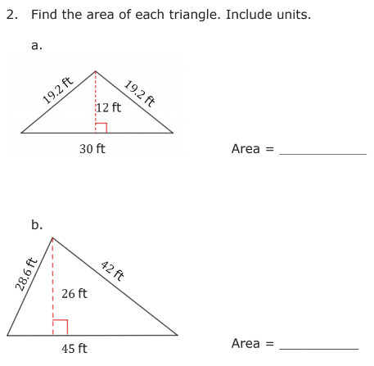
volume 1, pg. 307

Slide 20

Wrap-Up
volume 1, pg. 307

Slide 21
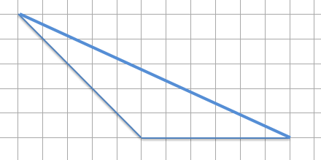

7.2.5 Wrap-Up: Ticket Out the Door
A diagram of a triangle is shown on a grid. The side length of each square on the grid represents $1$ foot (ft).
Label a base and its corresponding height for the triangle.
Find the area of the triangle. Include units.
volume 1, pg. 307

